Slide 1
CHINOOK MEDIA STORE
Unlocking Customer Potential: A Look at Sales Trends, Behavior and Genre Preferences.
CUSTOMER INSIGHT ANALYSIS REPORT PRESENTED TO THE MARKETING AND SALES TEAM
PRESENTED BY FAVOUR AKPAN favourina.akpan@gmail.com

Slide 2
Introduction
Problem Statement
Our digital media store boasts a vast music catalog and a loyal user base, yet we are underleveraging this potential.
By unlocking deeper insights into sales trends, customer behavior, and genre preferences, we can unlock significant growth. This data will empower us to optimize marketing strategies, maximize sales, and retain high-value customers.
Objective
Empower the CMO to develop data-driven marketing campaigns that target specific customer segments based on genre popularity and high-value customer insights.
Equip Sales Managers to maximize sales opportunities by leveraging insights into top-selling products, seasonal trends, and customer behavior.

Slide 3
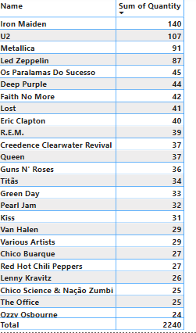
Top-Selling Artists
The heartbeat of our digital media store is driven by a select group of top-selling artists. These artists, whose names are synonymous with high sales, have captivated audiences over time.
The table indicates that Iron Maiden sold the most units (140) among the artists listed, followed by U2 (107) and Metallica (91). Led Zeppelin and Os Paralamas Do Sucesso come in at fourth and fifth place, respectively, with 87 and 45 units sold.
This is no surprise as Iron Maiden are considered one of the most influential heavy metal bands of all time, and their music continues to inspire new generations of musicians.

Slide 4
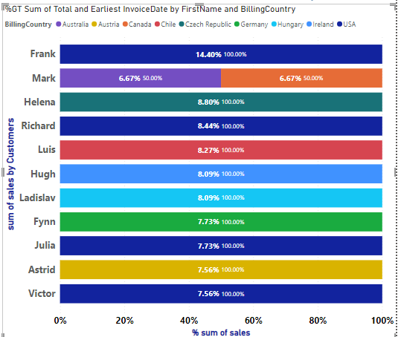
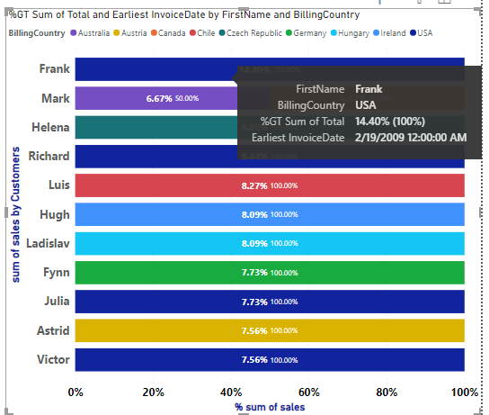
Customer Purchase Patterns
Frank has the highest percentage of total purchases
The earliest invoice date for Frank indicates a long-term customer relationship.
The sales distribution among other high value customers is relatively even, with most customers contributing between 7% and 9% of total sales.

Slide 5
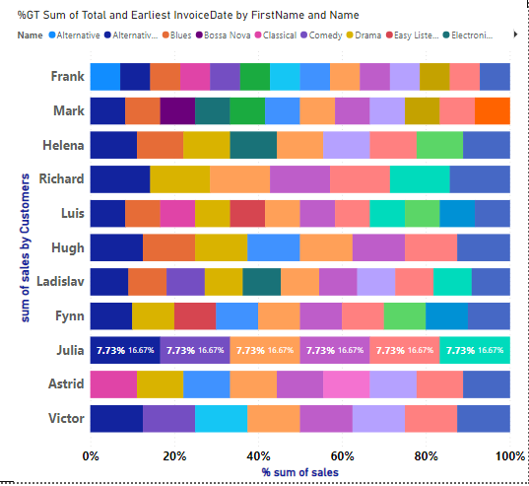
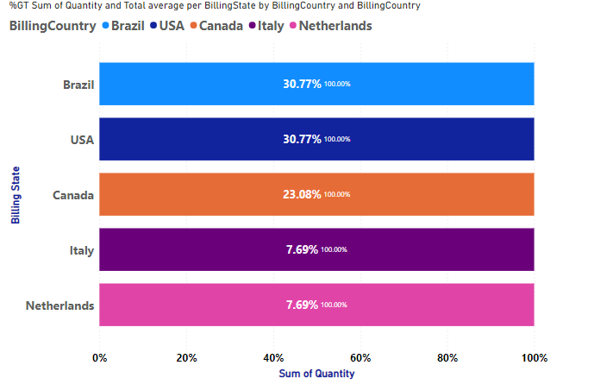
Customer Purchase Patterns
The majority of the media store's customers are from Brazil and the USA, followed by a significant portion from Canada, with smaller but notable contributions from Italy and the Netherlands.
This distribution can help the store tailor its marketing and inventory strategies to better serve these key markets.
High value customers enjoy an eclectic mix of genres.

Slide 6
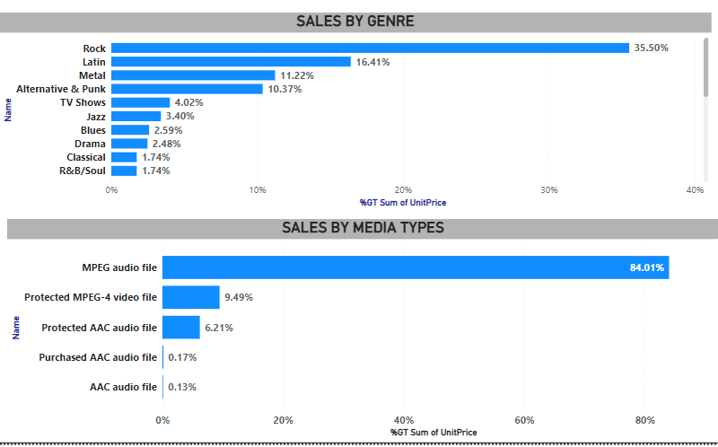
Genre Popularity
Music genres are the soul of our Store, and their popularity shifts like the tides. By analyzing genre trends, we uncover fascinating shifts in listener preferences.
Rock and Latin music are the most popular genres, with Rock leading significantly. Metal and Alternative & Punk also have strong followings.
MPEG audio files dominate the sales, followed by a smaller but notable share of protected video files. Other audio file formats have much lower sales.
These insights will enable us curate genre-specific promotions and anticipate future trends.

Slide 7
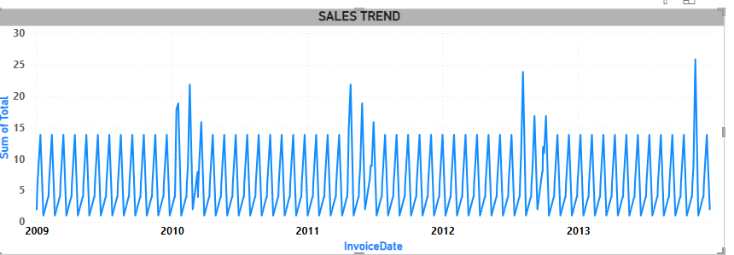
Sales Trend
The baseline sales appear relatively consistent, generally fluctuating between 5 and 15 units. This indicates a mature market
.
There are several outliers around December where sales exceed 20 units, indicating exceptional sales periods.
These outliers might be due to special promotions, new releases, or holiday seasons that boost sales significantly.

Slide 8
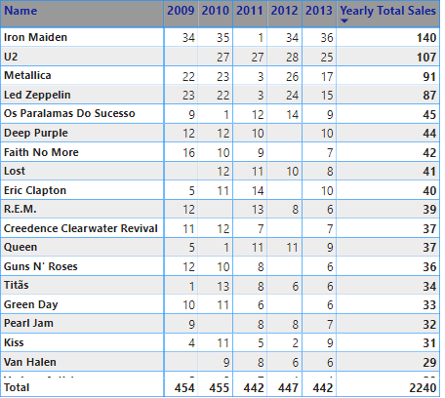
Sales Trend
Overall, sales appear relatively flat: There is no major upward or downward trend across the five year period. Sales total around 450 units each year.
Iron Maiden is a consistently selling artist: Iron Maiden is the only band listed that appears to have sold albums every year throughout this period. While not necessarily a top seller each year, their consistent sales performance is interesting to note.
The regularity of these fluctuations indicates a stable pattern of customer purchasing behavior over time.

Slide 9
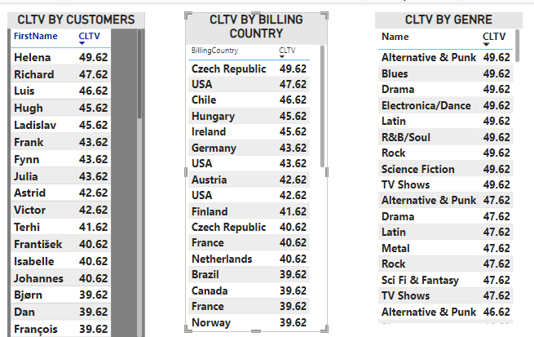
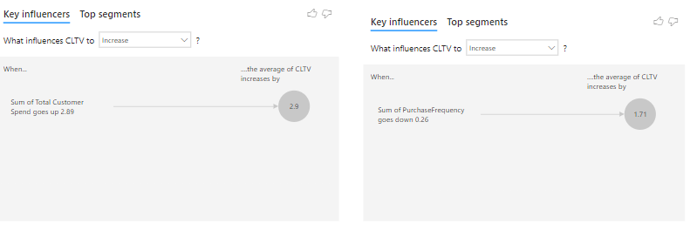
Customer Lifetime Value (CLTV)
Customer Lifetime Value is a critical metric, revealing the long-term worth of our patrons. By calculating CLV, we identify customers who provide the most value over time.
Overall, the key influencers chart suggests that Chinook’s CLTV is likely to be higher when customers spend more overall, even if they buy a little less frequently.

Slide 10
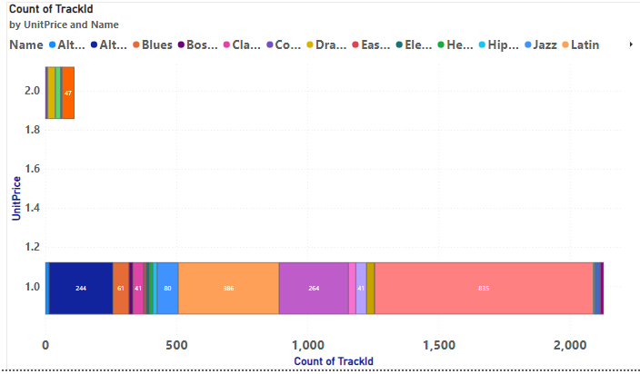
Market Basket Analysis
Examining common purchase combinations through market basket analysis unveils intriguing patterns.
The insight that customers purchase more when prices are under a dollar can guide several strategic decisions, from pricing and promotions to inventory and customer segmentation.
The key is to balance volume with profitability, ensuring that the strategy not only increases cart size but also contributes positively to the overall business objectives.

Slide 11
Recommendations
Leverage Top-Selling Artists: Create targeted marketing campaigns for Iron Maiden, U2, and Metallica, including exclusive offers, product bundles, and merchandise promotions.
Promote Popular Genres: Develop promotional content and playlists for Rock and Latin music, and consider hosting genre-specific events or collaborating with influencers in these genres.
High-Value Customer Engagement: Segment high-value customers like Frank and create personalized campaigns with exclusive discounts, early access to new releases, and VIP experiences.
Localize Marketing Efforts: Tailor marketing messages to cultural preferences in Brazil, the USA, Canada, Italy, and the Netherlands using localized content and regional artists.
Promote MPEG Audio Files: Feature these top-selling formats, showcase their benefits, and bundle them for extra sales
Holiday Sales Boost: Leverage peak December sales with targeted marketing! Implement festive promotions, curated gift guides, limited-time offers, and engaging events.
Boost CLTV: Encourage customers to Spend More and Buy More Often by creating bundles of lower priced items.

Slide 12
Conclusion
By implementing these recommendations, Chinook Media Store can leverage its strengths, address its current market dynamics, and strategically plan for future growth.
The focus should be on maintaining customer loyalty, optimizing product offerings, and capitalizing on seasonal trends to drive sales and enhance overall customer value.

Slide 13
THANK YOU!

